Slide 1
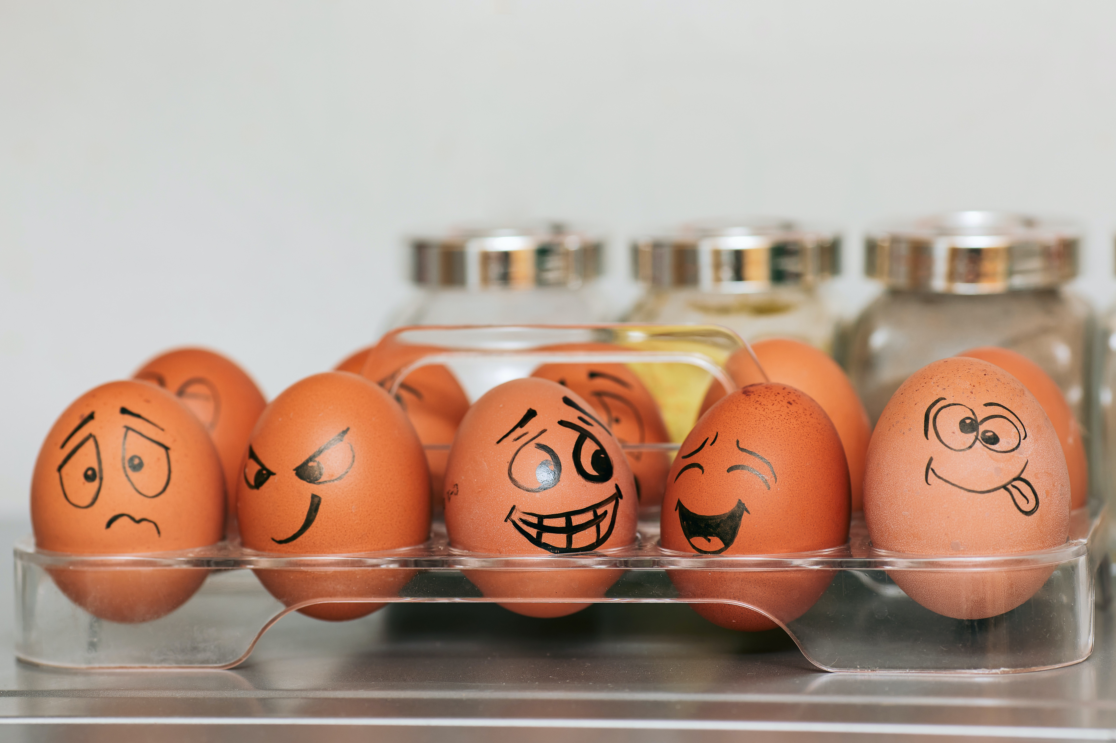
The Happiness Project
Australians and how they feel about life on any given day
October 2023
A complimentary report

Slide 2

When The Evolved Group first started work on Conversational AI, before EVE was created, we needed a way to explore how people engaged with chat personas and how to analyse conversational data.
We developed the concept to ask Australians how they felt over the last 24 hours followed by a chat.
We’ve been asking this question in its current form since 2021 . It provides a unique base of insights into the hearts and minds of Australians. We are calling this the Happiness Project.
This is the second of a series of reports that we will publish quarterly. We hope you enjoy the read!
Why does Evolved track national happiness?
Provide you with useful insights
Explore humans – it’s what we do
Test our technologies
Our clients track many things, including their brand and customer experiences.
What we track happens in a world where things happen that are outside of your control. How people feel affects how they feel about your brand experiences.
Tracking mind and mood provides context.
We love this stuff – we want to know what makes humans tick. We want to share our learnings because it is interesting and fun.
If we can understand happiness, perhaps we can all achieve a little more of it ourselves.
We’re called Evolved for a reason…we keep doing it. To do it well, we have to test and explore technologies.
The Happiness Project has given us many breakthrough moments with applied Conversational AI, and enables us to establish global leadership in its application in research.

Slide 3





Project objectives
How we track happiness
1
Track the mood of our nation and overall happiness
Please use the slider below to indicate how you felt over the last day (24 hours)?
The Evolved Omnibus is a nationally representative tracking study that runs 12 months of the year with 1,000 surveys each month. The surveys are collected from the Pureprofile panel.
The sample is quota controlled with weekly representative targets set on age, gender and location (state).
The questions take 2 minutes to complete and comprises three questions – see right
In this October report, we are only focused on the first two questions. We will analyse how time spent influences happiness in future editions.
Delve into our nation’s collective inner self
Smile Badge
Morphic Differential Scaling
2
Why do you feel that way today? Feel free to share what is on your mind
3
Understand the factors that lead to happiness and unhappiness
EVE Conversational AI
4
Provide context for the many brand and tracking reports we deliver to our clients
…and in the last 24 hours, how many hours did you spend doing the following?
Survey Shaper – allocate hours across categories

Slide 4
The Happiness Report – Edition 2, October 2023
The Happiness index reached a high of 69.5 in September 2023 before dropping off in October. The research tells us, however, that a significant minority of Australians, one in five, are unhappy. This group tend to be younger and female and financially disadvantaged, an issue that is being amplified by cost-of-living pressures as interest rates rise
01
So What: Happiness is important, perhaps the most important measure of social wellbeing. Fun fact, Bhutan adopted Gross National Happiness as a key indicator. Read here to find out more https://worldhappiness.report/
Happier Overall
Compared to the same period last year and year to date, Australians are happier overall in 2023.
Goodbye COVID
Increased happiness is associated with Australians getting out and having more life experiences. COVID Is now essentially a memory.
02
So What: COVID really messed stuff up – we still see mentions of it in the comments but almost 3 years after its onset, things are starting to look normal again. That data shows how important lifestyle and normal daily experiences are to happiness.
03
So What : Gen-Z face particular challenges and one in four of this generation are unhappy. What can be done? The financial challenges Australians face hit this group hardest. It is important for Government to ensure intergenerational equality and provide a ladder to financial security.
We need to talk about Gen-Z
This group, people under 28, are the least happy Australians, but they are getting happier, thankfully
Show me the money
Financial issues are the root of much unhappiness, particularly for Gen-Z. This is an increasing issue.
04
So What: Pervasive in our data is the impact of financial security on happiness. Of course, all factors are related in a complex web of causality, but financial security makes it so much easier to be happy. Did you know Australia is mid table in the OECD for financial inequality https://data.oecd.org/chart/7gk9

Slide 5



The State of Happiness…
Whilst we hear a lot of doom and gloom in the media, which is often dominated by negative click bait headlines, the reality is that Australians are happier this year compared to 2022, at least until October.
The increase is + 0.7 points over the corresponding calendar year to October 2022. Prior to a dip in October, happiness had been trending up since February, where it was at a low point post Christmas.
Mood rating (0-100)
Despite the drop off in happiness in October, year on year the score from October remains up by +2.2 points, which is a significant year on year increase.
 | Index
YTD to October 2022 (n=12,486) | 66.4
YTD to October 2023 (n=9,599) | 67.1
Change | +0.7
Base: n=24,781
↑ ↓significantly higher lower at p<.05 versus overall average | | *Caution, base < n=30

Slide 6
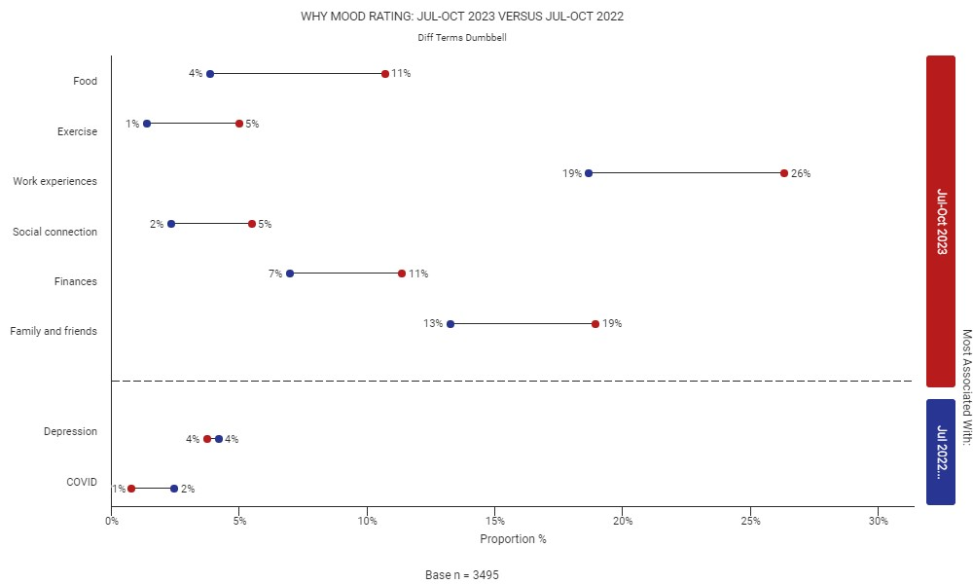

These improvements are related to the tail end of COVID
As COVID recedes, we’ve continued to see more people ‘living’ - that is eating, exercising, working, socialising, worrying about money and spending time with family and friends. This is making many people happier
“
Differentiating terms Dumbbell Chart – Prepared with Text Explorer
I am happy its Friday and I am looking forward to the weekend. I have a few things planned. I'm also looking forward to a rest
That sounds great! What type of activities have you got planned for the weekend?
I am going shopping and hanging out with family and friends
How does spending time with your family and friends make you feel?
It makes me feel happy and relaxes me
What do you enjoy most about getting to spend time with them?
I enjoy finding out how they are doing. I care for my mum so I take her out on the weekends. She likes to shop.”
”
Base: n=13,399
↑ ↓significantly higher lower at p<.05 versus overall average | | *Caution, base < n=30

Slide 7




But, if you walk past 100 strangers on your way to work, one in five of is having a shit day
….the rest are going ok – with 40% having a pretty good day.
“
“
“
Cost of living is sky high, I went to buy basic essentials which usually cost me about $30 and on this trip it cost $87. Very basics like A2 milk few months back would cost $5 and now it's about $6.60, everything has gone up but my wage has stayed the same. Interest rates are really having a impact to the cost of everyday living
Thanks for that. Could I hear some more about your thoughts on the cost of living?
Bread, Milk, fruits and veg are most important and things that my family cannot go without however the cost of these items keeps increasing. Interest rates is the worse and eating into the household budget
I just feel everything is well balanced on my life. I have created goals for the new year and I’ve dedicated time and effort into manifesting these goals.
Thanks. Could I hear some more about your goals?
I want to be financially and healthily secure within myself. As I have gotten older, I have realised I want to stop living pay check to pay check and ensure that I am set up for the future
I am quite a positive person and very happy all the time.
That's great to hear! What kinds of activities do you do to maintain your positivity?
I enjoy life and like motorcycling or road trips in my classic car.
How does going out on a ride affect your positivity?
It's good to be on the road and enjoy the enviroment.
What aspects of going out on a ride do you think help you stay positive?
It's a fun thing to do. I enjoy it greatly.
”
”
”

Slide 8

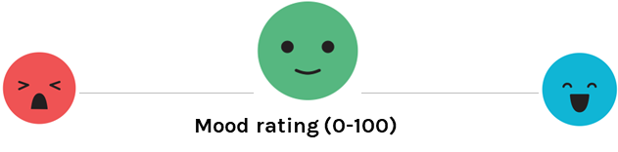
It seems if you want to be happier, go north and multiply…
Strangely, the further north people live, the happier they are. The Northern Territory is our happiest state or territory this year, followed by Queensland and New South Wales.
NSW and Victoria have both shown significant increases in happiness year on year (+1.1 and +1.2 respectively).
Tasmania remains where Australians are least happy – to put this another way, 22% of Tasmanians sampled are unhappy (rated their happiness 0-50 points) compared to 17% in the Northern Territory.
Happiness by State (YTD YoY Comparisons)
YTD-Oct 22 | 67.3
YTD-Oct 23 | 69.1
Change | +1.8
NT (1)
QLD (2)
YTD-Oct 22 | 67.8
YTD-Oct 23 | 67.9
Change | +0.1
YTD-Oct 22 | 67.5
YTD-Oct 23 | 67.2
Change | -0.3
WA (3)
YTD-Oct 22 | 66.8
YTD-Oct 23 | 67.9
Change | +1.1
NSW (2)
YTD-Oct 22 | 64.3
YTD-Oct 23 | 65.6
Change | +1.3
SA (6)
YTD-Oct 22 | 63.2
YTD-Oct 23 | 66.8
Change | +3.6
ACT (4)
VIC (5)
YTD-Oct 22 | 65.1
YTD-Oct 23 | 66.3
Change | +1.2
TAS (6)
Base n=24,781 - NSW (n=2,940), VIC (n=2,466), QLD (n=1,934), SA (n=729), WA (n=1,014, Tas (n=277), ACT (n=157), NT (n=82)
↑ ↓significantly higher year to date at p<.05 versus overall average | | *Caution, base < n=30
(rank YTD 2023 calendar year)
YTD-Oct 22 | 64.8
YTD-Oct 23 | 63.9
Change | -0.9

Slide 9


Break it down…
Wealthy older males still the happiest. What can we do to help our kids… Gen-Z are slightly happier, but still less happy
The average Australian rates their day 67 out of 100
Guys are happier, the gap has widened
Regional less happy, closing the gap
Many in Gen-Z are not happy, taking a leaf out of the book of their parents in Gen-X
The rich remain happy, even if they are a little less buoyant about life
BY LOCATION
BY GENERATION
BY HOUSEHOLD INCOME
 | YTD-Oct 22 | YTD-Oct 23 | Change
Male | 67.6 | 68.6 | +1.0
Female | 65.1 | 65.6 | +0.5
 | YTD-Oct 22 | YTD-Oct 23 | Change
Metro | 67.2 | 66.7 | -0.5
Regional | 66.4 | 67.3 | +0.9
Rural & Remote | 66.3 | 67.1 | +0.8
 | YTD-Oct 22 | YTD-Oct 23 | Change
Silent Gen | 71.1 | 72.5 | +1.4
Boomer | 70.0 | 71.2 | +1.2
Gen-X | 65.5 | 65.0 | -0.5
Millennials | 65.5 | 66.6 | +1.1
Gen-Z | 61.6 | 63.6 | +2.0
 | YTD-Oct 22 | YTD-Oct 23 | Change
$200k + | 71.0 | 70.2 | -0.8
$150k - $199.9k | 67.5 | 68.6 | +1.1
$80k - $149.9k | 66.6 | 67.4 | +0.8
< $80k | 65.3 | 65.6 | +0.3
Base: n=13,399
↑ ↓significantly higher lower at p<.05 versus overall average | | *Caution, base < n=30

Slide 10
Up to October, things were looking better for Gen-Z
Whilst Boomers made gains, they have dropped back since mid-year whilst other generations have generally shown improved happiness. Until recently, Gen X had been getting progressively less happy.
Gen-Z – Making up lost ground
Millennials – Measured gains
Gen-X – Stuck in a rut
Boomers – Boom and Bust
Base: n=24,781 (note Monthly Happiness sample was halved in July 2023)
↑ ↓significantly higher lower at p<.05 versus overall average | | *Caution, base < n=30

Slide 11
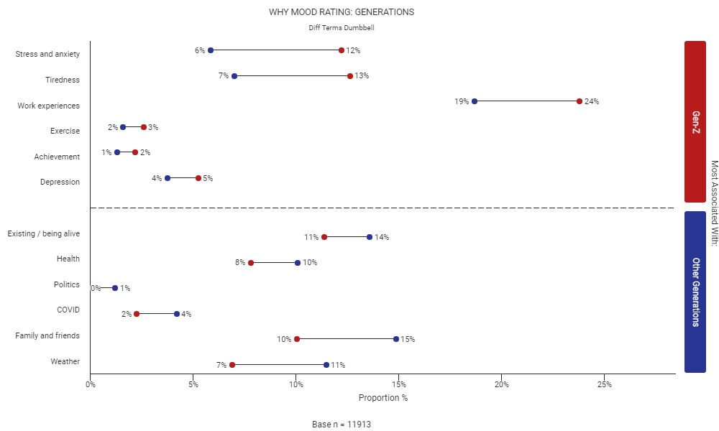
Gen-Z, The Gamer Generation - stressed, tired, unhappy at work
Older Generations are much more likely to be enjoying the simple things in life – like being alive, their health, family and friends and weather.
Financial stress: Financial challenges, such as student loan debt, high living costs, and difficulties finding well-paying jobs.
Work-related stress: Stress and pressure in the workplace, including long hours, job insecurity, and a lack of work-life balance.
Family issues: Family conflicts, strained relationships, and high expectations from parents can contribute to unhappiness.
Health concerns: Mental health issues, such as anxiety and depression
Relationship problems: Difficulties in romantic relationships, friendships, or social interactions can negatively impact their overall happiness.
Lack of motivation and feeling overwhelmed: The constant exposure to high expectations and the need to navigate complex societal issues can lead to a lack of motivation and feeling overwhelmed.
Differentiating terms Dumbbell Chart – Prepared with Text Explorer
Base: n=13,399
↑ ↓significantly higher lower at p<.05 versus overall average | | *Caution, base < n=30

Slide 12
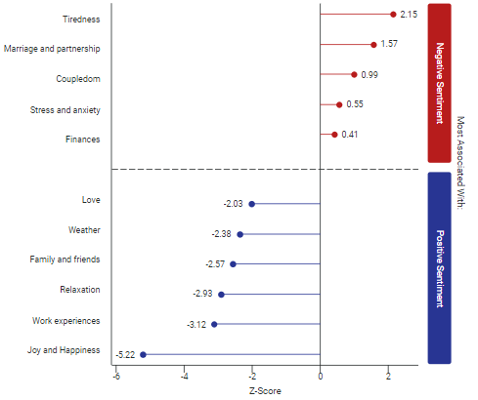
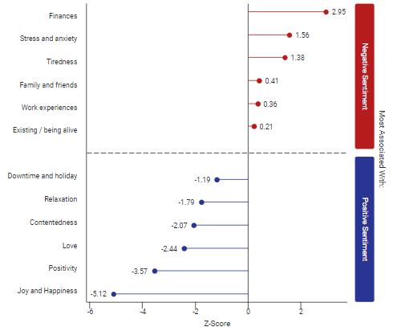
“Money doesn’t make you happy” [Quote, Some Old Rich Boomer]
There is a stark difference in what drives negative sentiment based on age – Unhappy Gen-Z are significantly more likely to talk to EVE about Finances than unhappy Boomers who feel tired and are more likely to have marital issues
Differentiating terms Dumbbell Chart – Prepared with Text Explorer
Drivers of positive and negative sentiment
(Boomers)
Drivers of positive and negative sentiment
(Gen-Z)
Base: n=13,399
↑ ↓significantly higher lower at p<.05 versus overall average | | *Caution, base < n=30

Slide 13
It ain’t easy being Gen-Z
Financial factors are paramount, compounded by the pressures of expensive education, problems with work, young children and general lack of purpose
“
“
“
“
A little stressed but mostly positive
Thank you for sharing. I appreciate you being so open and honest. I encourage you to seek support, if needed.
Thank you
You're welcome. Can you tell me more about what is making you feel stressed?
I am nearly due to have a baby and now my youngest has covid so we’re separated and all my support people are also in lockdown with covid so if I were to go into labor I would be on my own
I understand how stressful this must be for you. What has been the hardest part of the situation?
Being separated from my son
I've had a lit of stress about family expectations, I often feel they don't care about me and that I may be a burden so living with my parents even though I do a lot of the house work
Thank you for sharing. I appreciate you being so open and honest. I encourage you to seek support, if needed.
Seeing someone about my problems is hard as I have social anxiety and I have terrible opening up to pale, even if they have my best interests at heart
I don't feel great or bad just in even
It sounds like you're feeling a bit neutral today. Is that usual for you or has it been a particularly challenging day?
its quite usual I will say, feel stuck in life and have been finding it hard to find joy or happiness in my life as of recently
That sounds difficult. Can you tell me a bit more about why you've been feeling this way?
well life is quite boring it iOS just work and home no in between. I'm just to tired to do things theses day
Just very tired. Feeling exhausted from the day before and feeling a need to sleep all day and do nothing. Excited to relax after all my exams I have undertaken
Thank you. You mentioned the exams. Could you tell me how the exams made you feel?
Stressed out because I didn’t prepare enough
”
”
”
”

Slide 14
This is a serious problem and it is a gendered problem
The unhappiness of our young female Australians is endemic – one in four (25%) of Gen-Z women surveyed said they were unhappy
“
I am actually not sure, maybe there is something up with the moon. But also cost of living and finances is stressing me out as well.
Could you let me know a bit more about your stress around finances?
I am self employed and I feel like things have started to slow down in my business which is stressing me out with all of the interest rate rises and my mortgage going up
That sounds tough. How have you been handling the financial strain so far?
By trying to reduce my spending on unnecessary things and budgeting properly
That sounds like an admirable strategy. Is there anything else that you think might help reduce the stress you are feeling?
Look for more part time work
Average Happiness Scores (0-100) by gender interlocked with Age (2023 data)
”
Base: Year to Date 2023, n=9,599
↑ ↓significantly higher lower at p<.05 versus overall average | | *Caution, base < n=30

Slide 15

Why are our young women so unhappy?
We provided all conversations from 2023 from Gen-Z men and women to our AI and asked it to summarise what’s going on…
“
Financial and other things in my mind, cost of living increasing is worrying
What specifically do you find worrisome about the cost of living increasing?
Will not be able to afford day to day living
What kind of changes have you had to make in order to cope with the rising cost of living?
Switch to cheaper brands, cut out luxuries, less days out as a family, buying second hand where we can to save money
What has been the most difficult aspect of having to make those changes?
Not being able to treat myself to things like getting my hair done and not being able to buy as much things for my son
The responses from both young women and young men tend to mention common sources of unhappiness such as financial stress, work-related issues, relationship problems, health concerns, and challenges in life.
In terms of differences, responses provided by young women mention experiences such as loss of a family member, illness, caring for a child, or dealing with chronic health issues like endometriosis.
On the other hand, responses from young men tend to touch on financial stress, job-related frustrations, relationship difficulties, and personal challenges.
”
“
I’m having a really stressful morning and I wish I never woke up today
Thank you for sharing. I appreciate you being so open and honest. I encourage you to seek support, if needed.
I will if I feel I need to thank you for your support
No problem. Can you tell me a bit more about why you're feeling stressed this morning?
I'm arguing with family
That can be difficult. Can you tell me what specifically is leading to the argument?
Money
That can be a tricky subject. How have recent financial setbacks impacted the conversation around money with your family?
I spend way too much some time and I really don't know how to stop
”

Slide 16
Personal and household finances is a burden for many Australians
Lower income, financially out of control, over extended, forced to sacrifice due to the mounting pressures of cost-of-living increases, feel like they have let others down.
Feeling a bit bleh at the moment with hayfever and money issues
Money issues can be very stressful. Can you tell me a bit more about the financial situation you're in?
We are struggling, these interest rate hikes have put us under a lot of stress, i am on maternity leave at the moment and were only on one income
Is there anything else you'd like to tell me about how you've felt in the last 24 hours?
Moody
Can you tell me more about why you've been feeling moody?
Pressures of raising kids
Feel generally good but just general life issues like cost of living, mortgage payments always at the back of my mind. Have a wedding coming up too.
How have those issues been affecting you lately?
It's hard to focus on everything without things coming back to money.
What are some other concerns that you have in your life besides finances?
I have a family so their health and well being is always my main priority. As mentioned still stressful planning a wedding too.
I have know reasons not to feel positive. Things are tough financially from day to day but I have a roof over my head, food to eat, clothes to wear, a car to driver and most importantly a loving family.
That's great to hear! Can you tell me more about why things are tough financially?
The current cost of living. Fuel, food, interest rates, insurance, etc all going up. So it's tough to budget and make sure everything is paid for. It means going without "luxuries" but that's ok, sometimes need to sacrifice and just carry on.
That's definitely a difficult situation to manage. Are there any specific strategies you use when budgeting to help make ends meet?
Not really, just continually monitors bills and expenses then prioritize in order of due date and ensure funds are available to cover.
That makes sense. How do you and your family cope when you have to make sacrifices due to your financial situation?
We just do. End of the day, most of the sacrifices are either eating out, going to a movie, not buying new clothes or the latest gadget. The time will come where we can buy these things and most of the times these things are not essential, must have items.
It is a good day but can be better
What would make it a better day for you?
Like winning a lotto’s or get some great deal of shopping
What do you think would be the best part about winning the lotto or getting a great deal on shopping?
Means I can save money or get some money
What has been the most significant challenge for you when it comes to saving money or getting more of it?
Cost of living in general

Slide 17
…so what do people who are positive about finance have to say
They tend to have satisfaction with their income, have low debt, feel financially in control, allowing more positive aspects of their life to come into focus
I feel quite good today as I have just been promoted at my job and am excelling in my studies. I've also just been on a date with my boyfriend.
That sounds wonderful! How has your promotion impacted your job?
I have gotten a higher income which will make the cost of living easier.
That's really great to hear! How has getting a higher income changed your day-to-day life?
I will be able to very comfortably keep myself financially stable.
That's really promising for the future! How does your boyfriend feel about you being promoted?
He thinks its great which is why we went out to dinner last night.
I have so many blessings that includes my wife, my work, and my health. I am also happy I have a roof to stay and I eat 3 times a day.
That's fantastic that you are thankful for all of these good things in your life. How has being thankful made you feel today?
Being thankful makes me pursue higher dreams and goals for both my wife and my g
What specific goals are you pursuing that make you feel good today?
I want to get more savings for my wife and future baby. I like them to stay healthy and safe. I like them to eat 3 times a day and have a roof to stay.
That is wonderful that you want to provide such security and stability for your family. How do you plan on achieving those goals?
I will save more money and spend less. I will only get what is needed for my family. Also, by writing the steps to achieve this goals would be my strategy.
Recently retired after long nursing career. Worked very hard during covid in big public hospital and have retired feeling financially secure and satisfied with my career.
That sounds like a great accomplishment! How has it made you feel, emotionally?
excellent and calm about retirement
That's great! How has that feeling of calm and security been impacting your day-to-day life?
Great positive attitude. Looking forward to travel and spending time with family. Debt free finally
That sounds like a wonderful feeling! What specific plans do you have in mind when it comes to travel and spending time with family?
Overseas trip to Europe this year. Have already been away with kids and grandkids
I’m in a fairly comfortable position, not financially mind you cause that’s still a struggle, and although we have some small health issues we are travelling very well and looking forward to our holidays
Thank you. Please tell me more about how the small health issues make you feel.
They are always a bit of a worry but on the positive side things could be that much worse

Slide 18


Appendix
Applied Insights Technologies

Slide 19






The Happiness Report – Analytical Framework
Our EVE Analysis is built around the idea of being human and the things that shape our emotional responses
What I see and hear
My mind
Information
The internal theatre
of the mind
Global and local news
Word of mouth
Social media
Politics
Meaning – how I interpret it
Relevance – does it matter to me?
Context – what else is going on with my life
Beliefs – how it gels with what I believe
What happens to me
My body and brain
Events
Physical response
Work
Family
Travel
Holidays & celebrations
Weather
Births, deaths, marriages
Energy levels – the ebbs and flows of physical and mental energy
Mood – how I feel and my motivationally
Stress and anxiety
Health – my broader body situation

Slide 20




Smile Badge – Morphic Differential Scaling
Smile Badge is a 100-point mobile first animated scale – as you move the slide the face changes from unhappy to happy in a seamless way.
Please use the slider below to indicate how you felt over the last day (24 hours)?
This is a non-verbal scale that gives us great fidelity not possible with a standard Likert scale. Once people rate their feeling, EVE gets to work with her moderation skills to discuss why they feel that way. We’ve also been recording how people spent their time in the preceding 24 hours they rated.

Slide 21
EVE, our Conversational AI companion
EVE uses AI to generate questions in a simulation of a human-to-human conversation
The fact is, our world is one of social media, where language is pervasive, and we express ourselves with words. These facts have guided our innovation on engaging with humans.
With EVE you can easily
Define a topic of interest
Identify specific sub-topics you want to explore with people
Specify how deeply you want to prompt and probe and in which areas (just like briefing a moderator)
Deploy it on your survey
Explore responses in real time
Why do you feel that way today? Feel free to share what is on your mind
Just went for a walk, sun is out, going to a job i hate this afternoon, i have a wonderful partner and home life
Thanks for that! Could you go into more detail about why you feel that way about your job this afternoon?
Not looking forward to it. i had a medical certificate not to go to work but work will not find me alternate duties

Slide 22

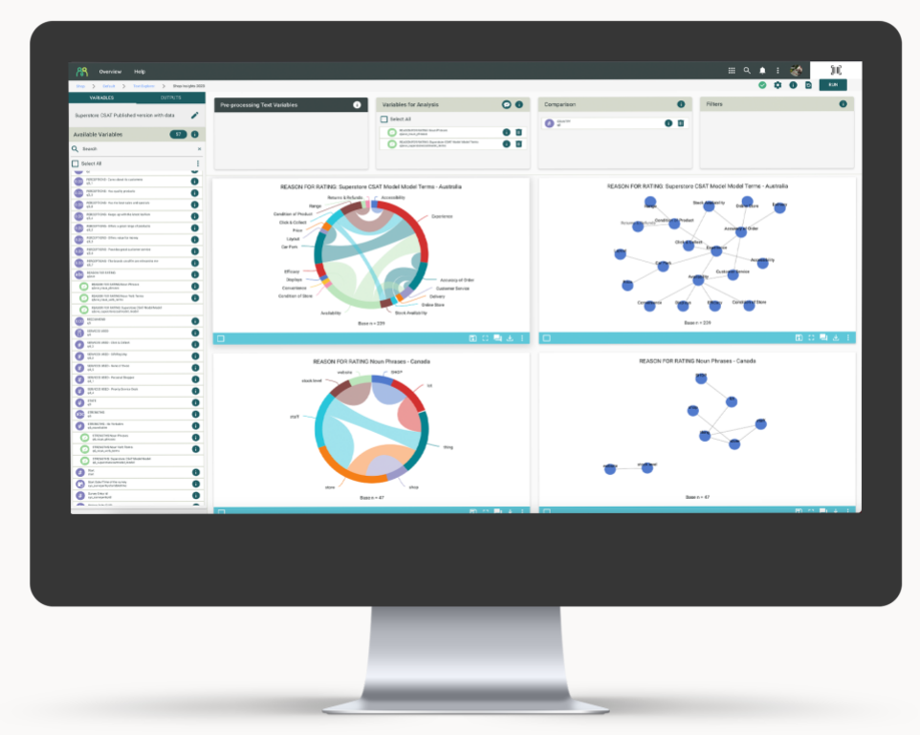
Text Explorer
The next generation Text Analytics in the box – explore, visualize and share, designed for conversational data as well as standard open ended survey text
  Overview
Text Explorer is an analytics tool to explore text and open-ended responses of any type more deeply.
Text Explorer allows you to run a library of text analytics outputs. Most importantly you can run large numbers of analysis comparisons across groups and export visualised results for your presentations.
  With Text Explorer, you can easily:
Code sentiment
Text clustering and segmentation
Compare groups and see how their feedback is the same or different
Run text-based driver models
Quadrant analysis (sentiment versus prevalence)
Topical mapping (correspondence analysis)

